Slide 1

Interactive maps
Samin Muhammad Al Mahi Taseen Hakim Sadman Md Sakib

Slide 2
Overview
Overview: This project aims to develop a Dijkstra’s algorithm for a custom bike routing app for the city of Kalamazoo and portage, Michigan, that recommends safe and efficient bike routes based on street typologies and stress levels.
Purpose: The purpose of the bike routing app is to promote active transportation and improve bike infrastructure by providing a user-friendly solution that prioritizes safety and convenience for bicyclists.

Slide 3
Objectives
Technical Objectives:
Shall implement Google Maps API to generate bike routes and shall allow users to toggle certain road typologies using radio buttons to change the route based on their preferences.
Shall implement a location-based service that accesses the user's current location and allow them to enter their destination address or click on a location on the map to set the destination.
Shall implement an amenities overlay on the map that shows amenities with photos and text descriptions.
Shall allow users to upload images and reviews for amenities, allowing them to provide feedback and contribute to the app's content.
Business Objectives:
Shall provide a user-friendly bike routing app that offers a convenient and efficient solution for navigating the city of Kalamazoo and portage.
Shall promote safer bike routes with lower stress levels, encouraging more people to choose biking as transportation option.

Slide 4
How the app works?
Shall generate the most efficient route using Dijkstra's Algorithm, taking the least amount of time.
Shall adjust the route according to selected street typologies while still providing the shortest route using the specified streets.
Shall display the route within 5 seconds of entering the destination.
Shall display amenity data, including images, reviews, and descriptions, within 1 second of selection.
Shall ensure consistent webpage response time as the number of users increases.

Slide 5
Dijkstra’s algorithm
Dijkstra's algorithm finds the shortest path in a graph with non-negative weights.
It starts at a source node and assigns tentative distances.
The node with the smallest tentative distance is selected and its neighbors are examined.
The process repeats until the destination is reached or there's no path.
It guarantees the shortest path for all nodes.
It can be implemented using a priority queue.
Time complexity is O(E log V) for a graph with V vertices and E edges.

Slide 6
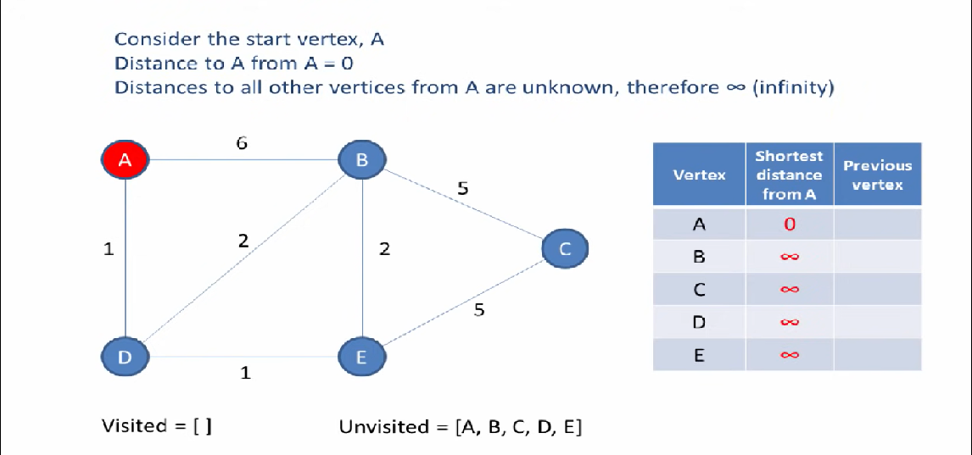

Slide 7
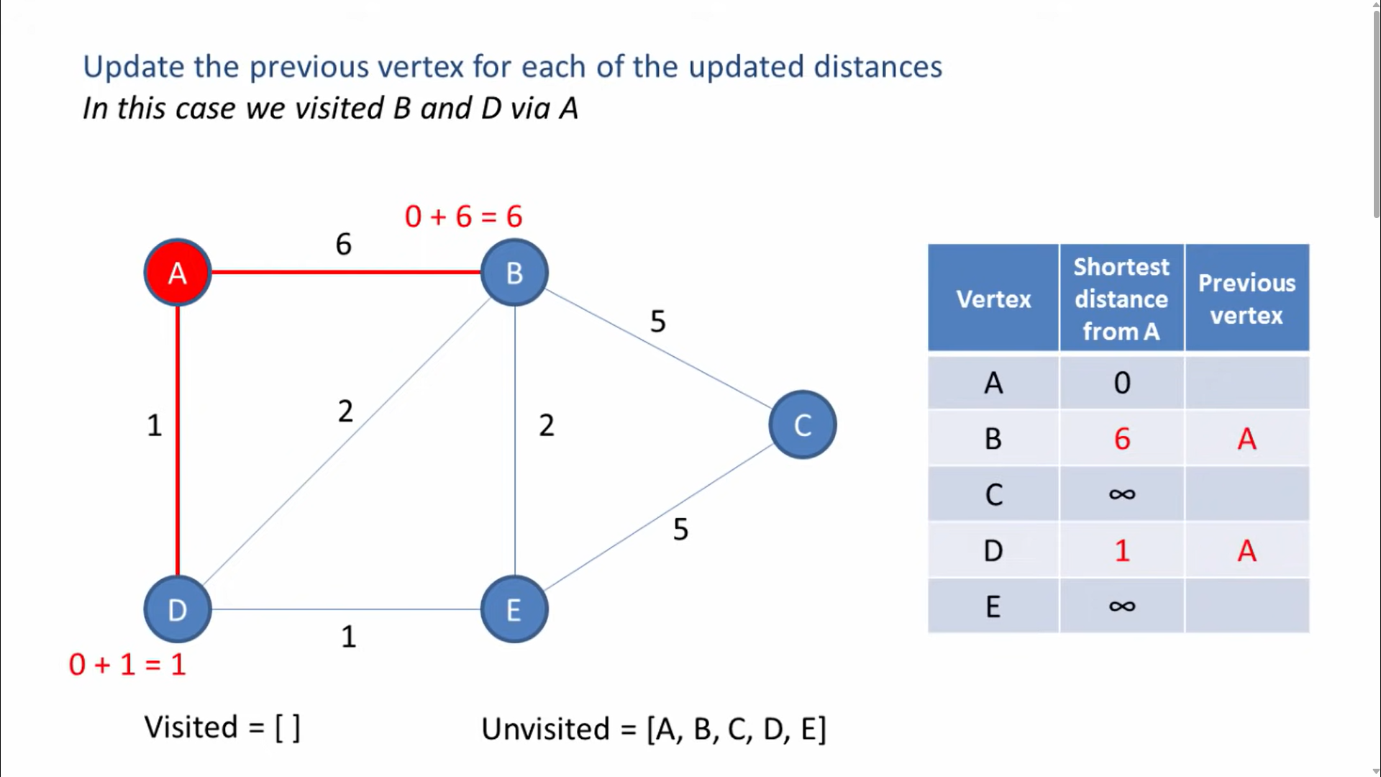

Slide 8
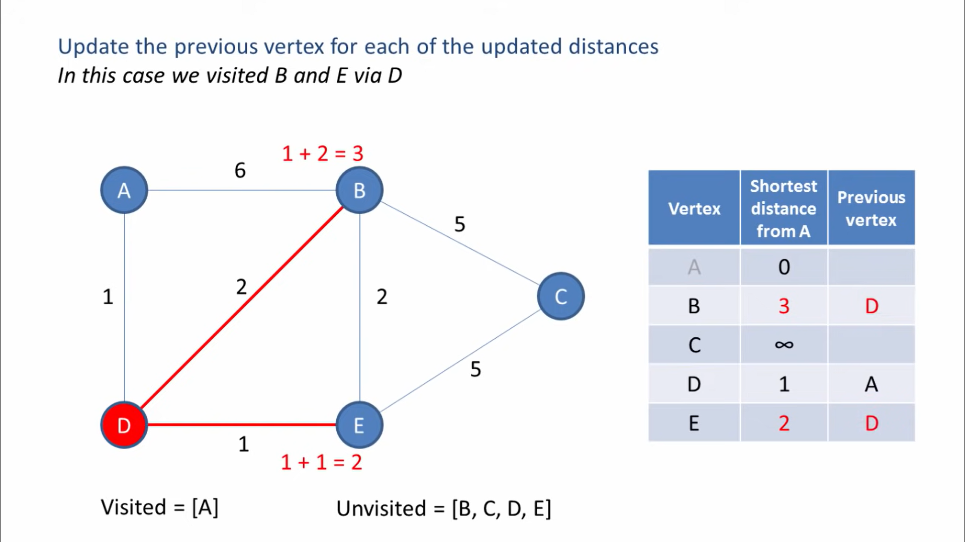

Slide 9
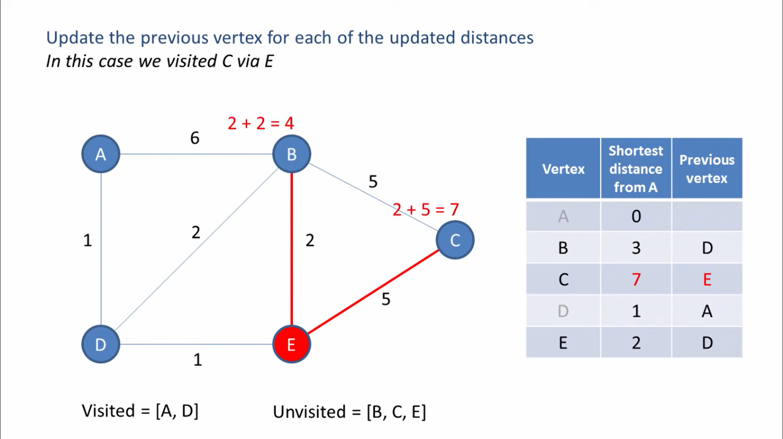

Slide 10
Functions used to code in python
Dijkstra’s algorithm
Draw_graph
Reset_graph
Color_path
Draw_edge & draw_node
Draw_edge_label
Class DijkstraGUI
Run_algorithm

Slide 11
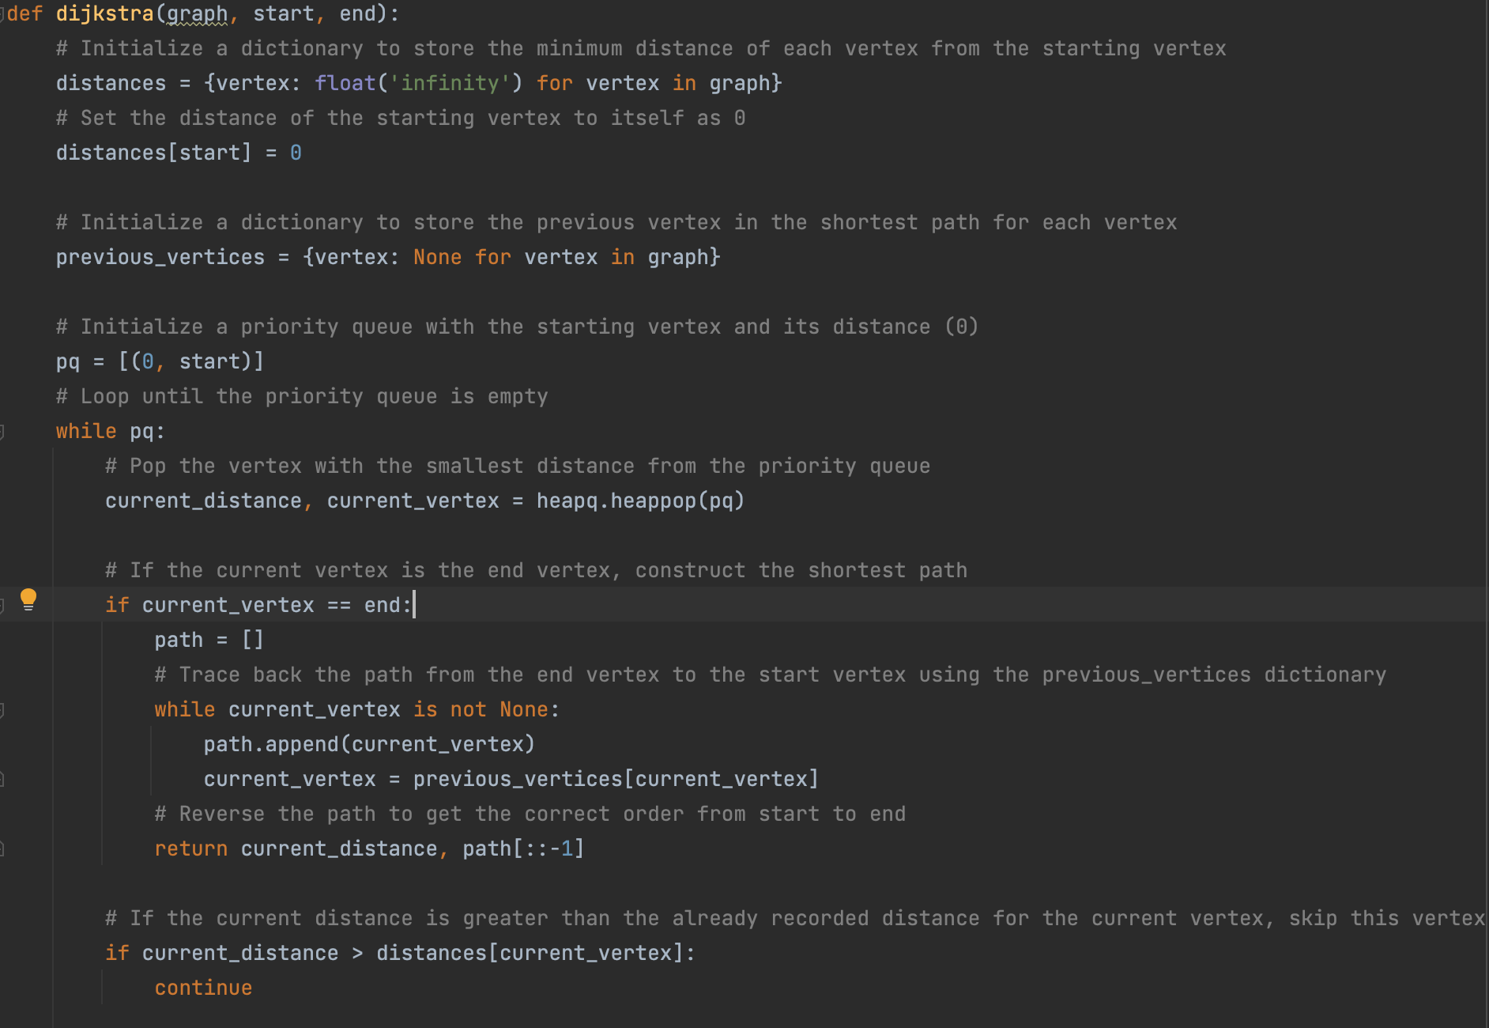
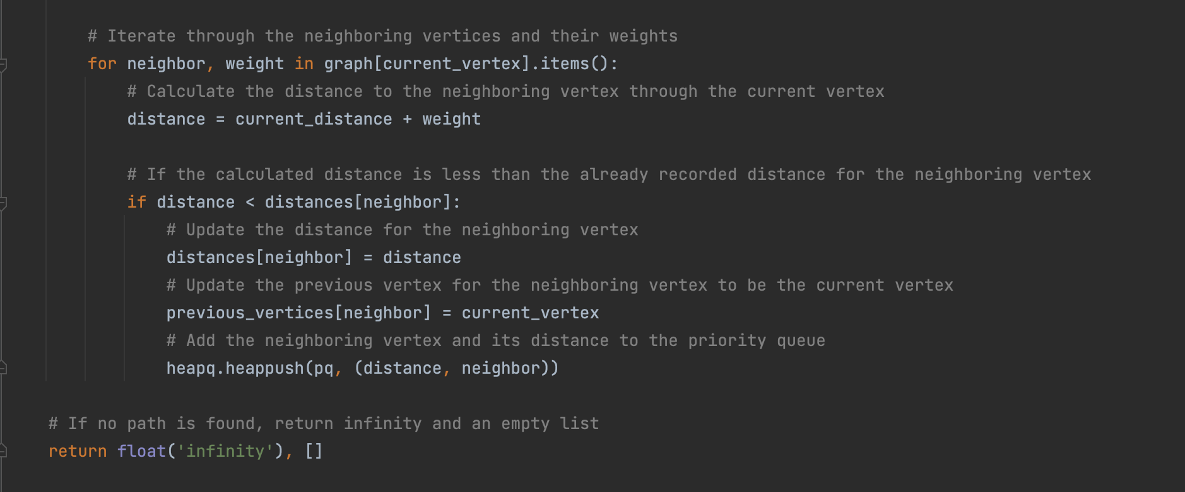
Code for the algorithm

Slide 12
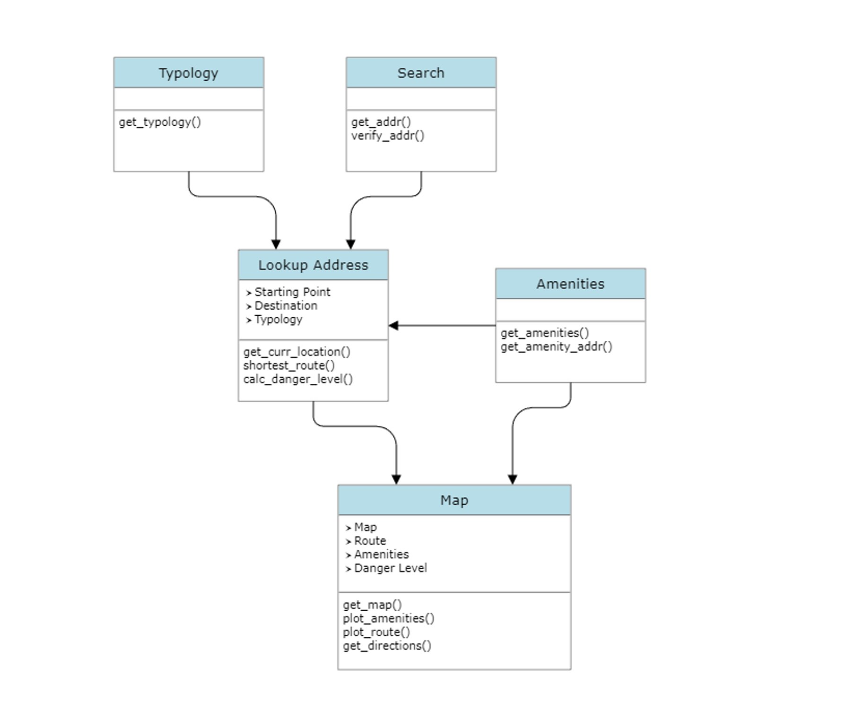
UML Diagram for the app

Slide 13
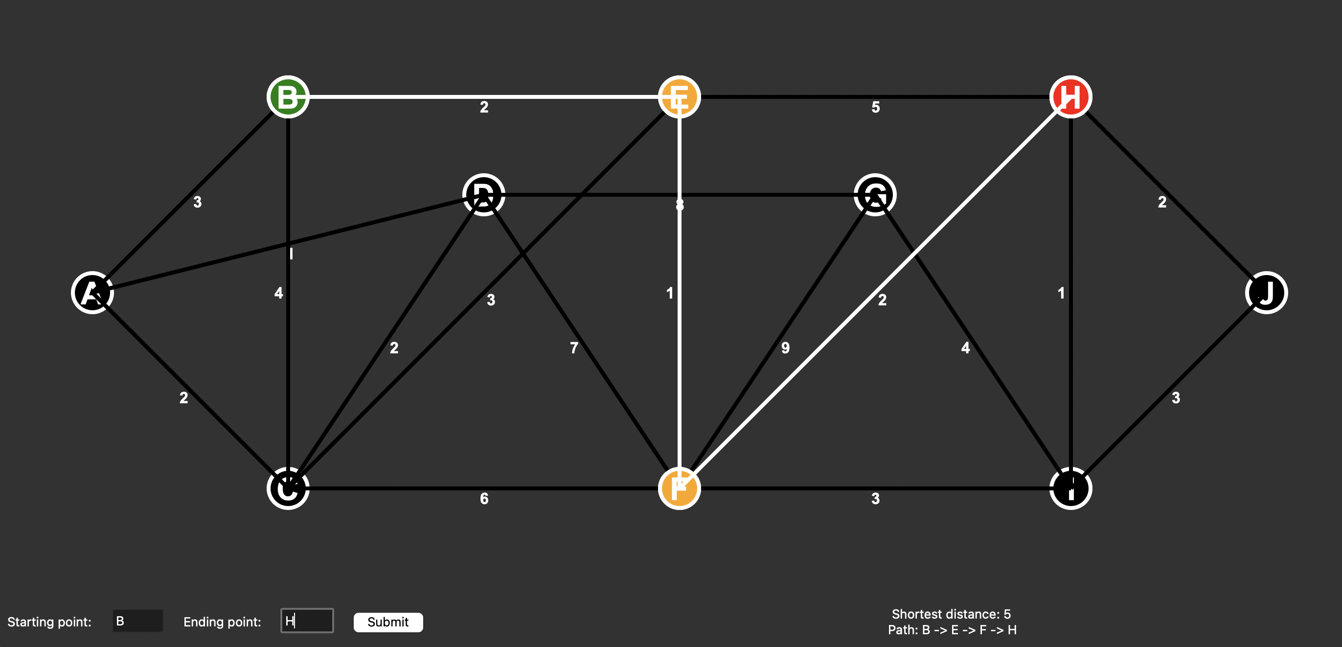
Screenshot of the mock GUI.

Slide 14
Explaining the mock GUI
The green node highlights the starting position on the graph where the value was taken from the user’s GPS location.
The red node highlights the ending position on the graph where the user has decided his destination.
The orange nodes highlight the stops/ pauses in the journey.
All the nodes and edges used are larger and highlighted in the graph.
There is an input for starting position and ending position.
There is a submit button which takes the inputs and finds the shortest distance and the path required in the result label.

Slide 15
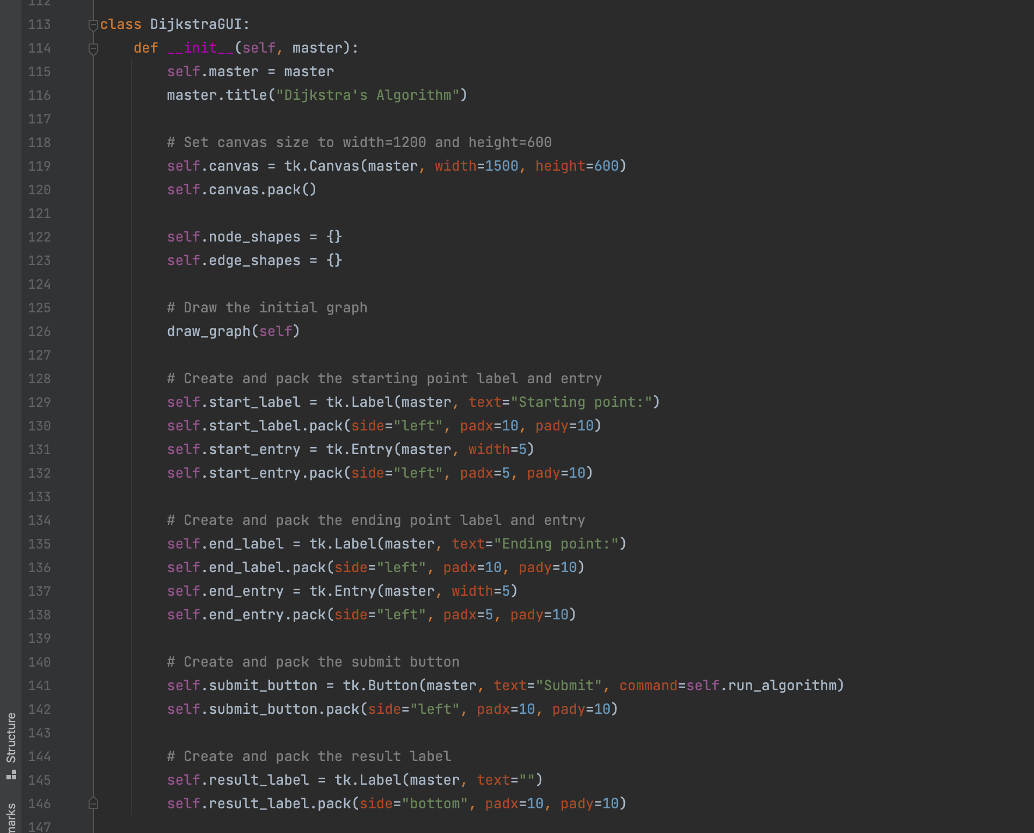
Backend GUI

Slide 16

Let us see the project together now.

Slide 17

Testing
To evaluate the performance of our graph algorithm, we conducted experiments during the testing phase.
We utilized the ‘testing.py’ script to run our experiments on graphs of different sizes.
We tested the algorithm on graphs with nodes ranging from 10 to 2000.
This helped us to examine the impact of the graph size on the execution time of the algorithm.
For each graph size, we created a random graph with random edges and neighbors for each node.
We then calculated the time required by our algorithm to process each graph.
Finally, we recorded and documented the results of the experiments.

Slide 18
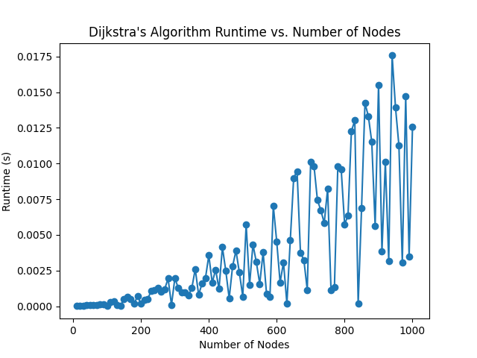

Slide 19
References
Dijkstra, E. W. (1959). A note on two problems in connexion with graphs. Numerische Mathematik, 1(1), 269-271.
This is the original paper where Edsger W. Dijkstra introduced the algorithm. It provides a foundational understanding of the algorithm and its conception.
Cormen, T. H., Leiserson, C. E., Rivest, R. L., & Stein, C. (2009). Introduction to algorithms (3rd ed.). MIT Press.
Chapter 24 of this widely-used textbook covers Dijkstra's algorithm in detail, including its time complexity and correctness proofs.
Wikipedia - Dijkstra's Shortest Path Algorithm This Wikipedia article provides a comprehensive explanation of Dijkstra's algorithm, its history, pseudocode, and practical applications.
GeeksforGeeks - Dijkstra's Shortest Path AlgorithmThis article on GeeksforGeeks explains the algorithm with examples and provides code implementations in multiple programming languages.

Slide 20

Thank you.

